Slide 1
Evidence Based Care & Resource Stewardship
Kaiser Permanente Resident Elective In Health Policy
October 18, 2017
Sameer V. Awsare, MD, FACP
Associate Executive Director, TPMG

Slide 2
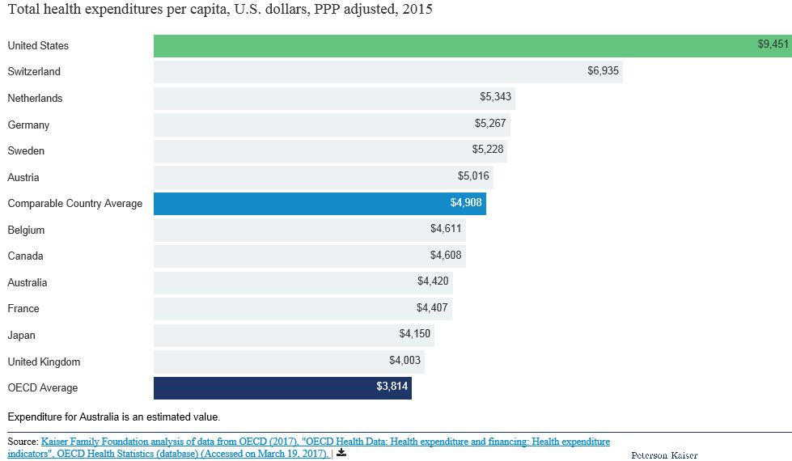
On average, other wealthy countries spend about half as much per person on health than the U.S. spends

Slide 3
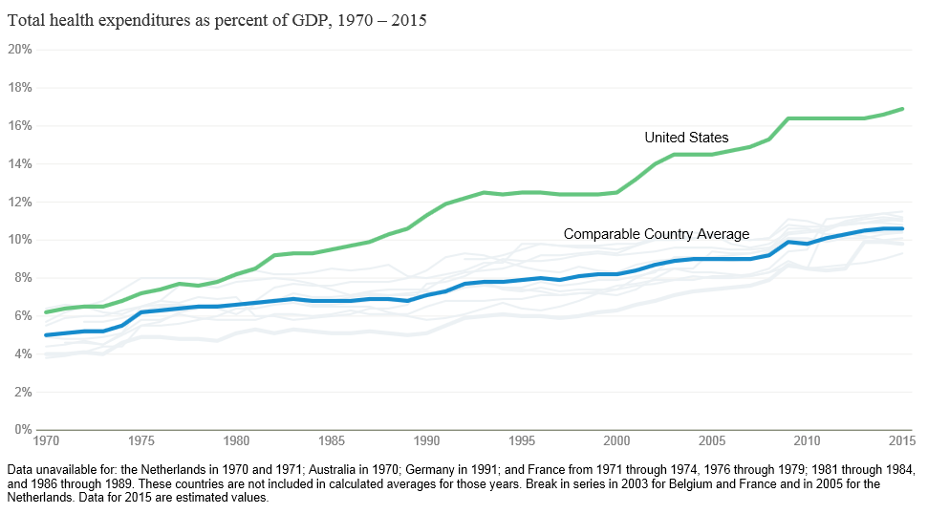
Since 1980, the gap has widened between U.S. health spending and that of other countries

Slide 4
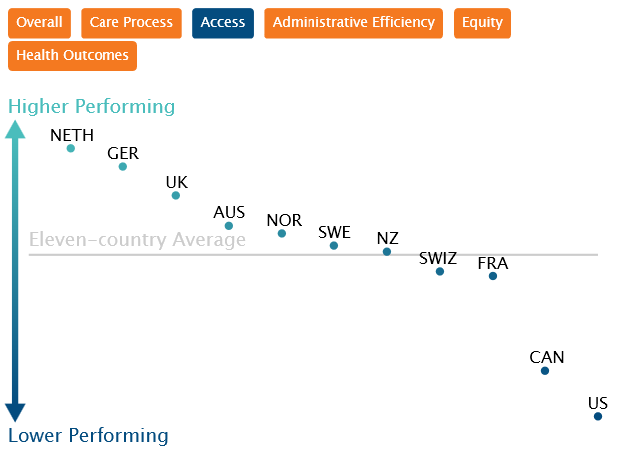
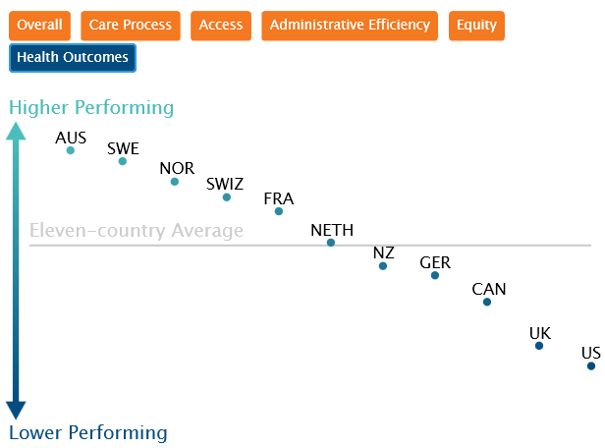
2017 Commonwealth Fund Health System Performance Scores

Slide 5
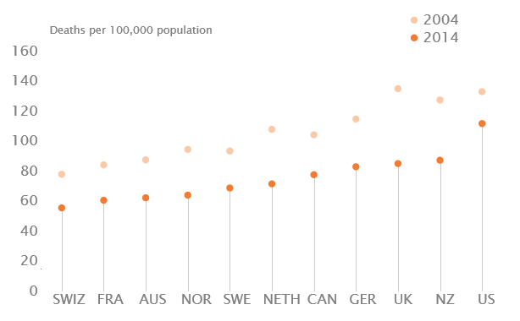
Mortality Amenable to Health Care, 2004 and 2014

Slide 6
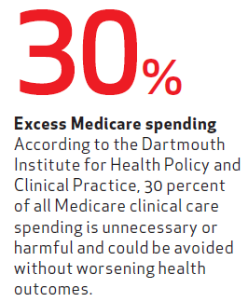
$750 Billion in unnecessary care per year
Prevention Failures
Inflated
Prices
7%
Fraud
10%
14%
28%
25%
Excess Administrative Costs
Unnecessary
Services
17%
Inefficient Care Delivery

Slide 8
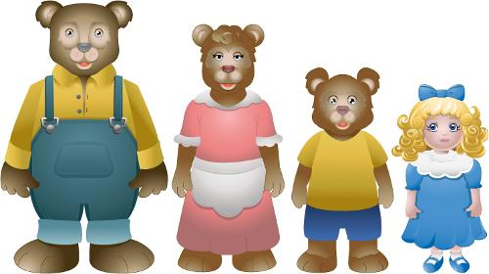
Underuse, overuse & misuse

Slide 9
What is underuse?
Underuse is when people are not given evidence based, medically necessary care.
Examples include immunizations, cancer screenings, control of chronic conditions, etc.

Slide 10
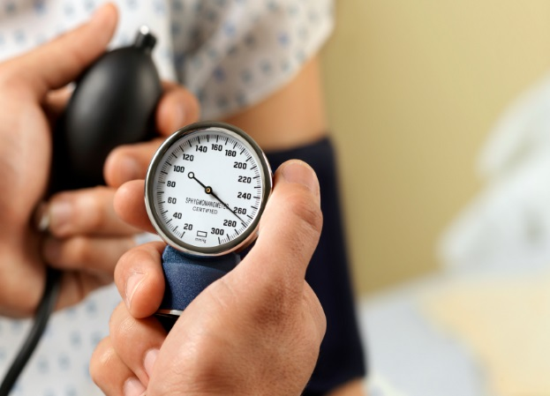
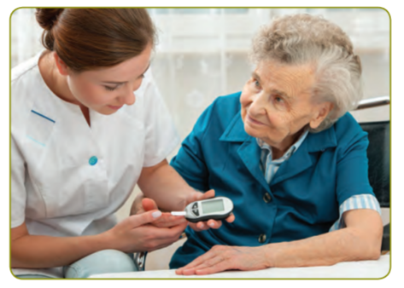
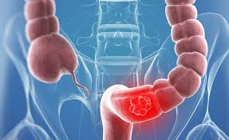
Underuse
54%
control
58% screening
53% commercial diabetics A1c < 7

Slide 11
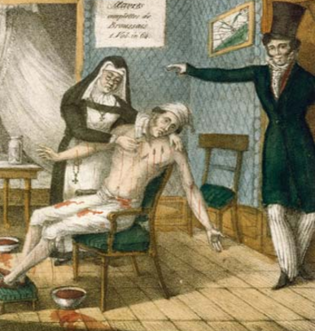
What is overuse
Overuse occurs when a drug or treatment is given without medical justification.
Examples include:
antibiotics for viral URIs or for OM in
children, MRIs for acute LBP without
red flags, CT for headache with
normal neurologic exam, etc.
In health care, more is not always better. More spending and treatment does not translate into better patient outcomes and health.

Slide 12
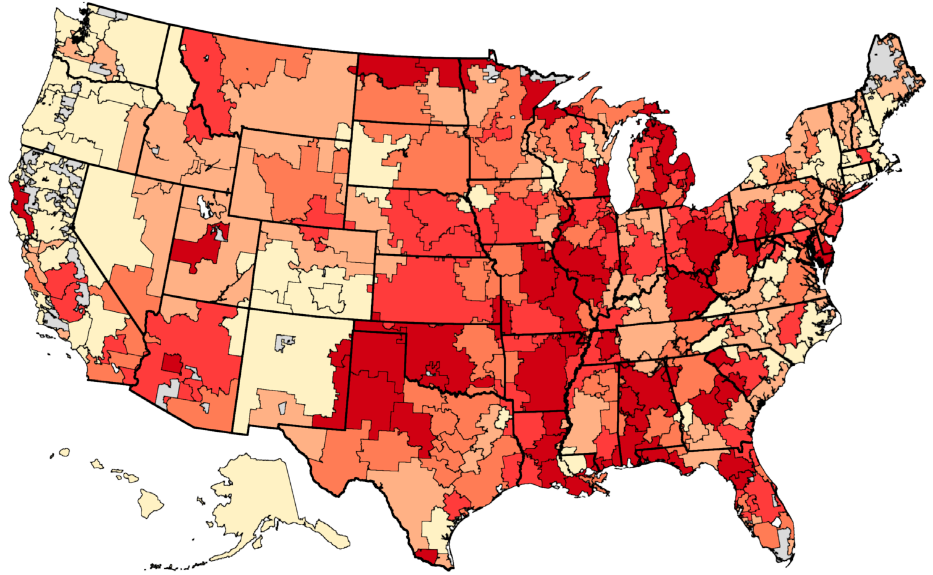
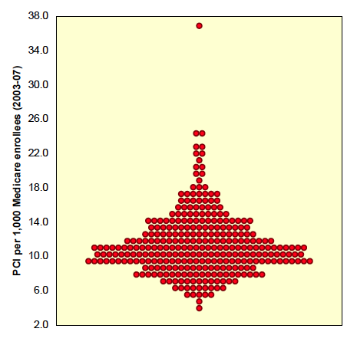
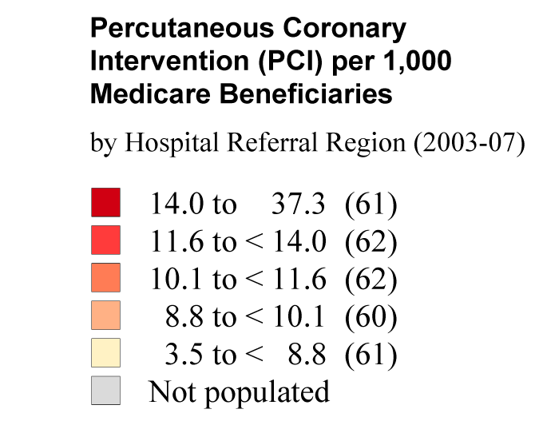
Darthmouth Atlas
Dartmouth Atlas
Notes:
This comes from the Dartmouth Atlas. It’s based entirely on Medicare data, because that’s the data that’s available. It shows the 10-fold variation in per capita rates of PCI among Medicare beneficiaries in each of 306 hospital referral regions in the US. Just notice that turnip graph in the lower left. Each dot represents one referral region and it just shows that a lot of regions have about 8-13 PCI’s per 1,000 beneficiaries. Notice the outlier at the top of the graph. Looking at this map, ikkt’s tempting to conclude that this variation is driven by differences in underlying levels of heart disease. It isn’t.
NEXT SLIDE

Slide 13
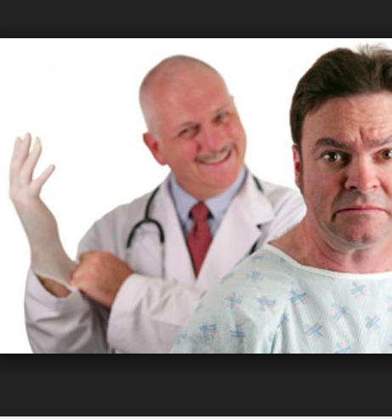
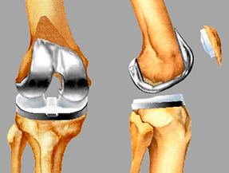
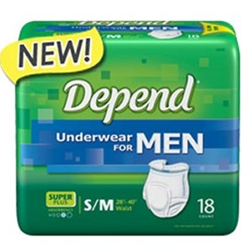
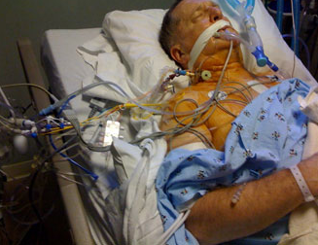
Overuse
30% arthroplaties
Are inappropriate
23% of colonoscopies are inappropriate
>50% prostate
Procedures are
inappropriate

Slide 14
What drives overuse?
Poor knowledge of evidence
Fear of uncertainty
Devotion to technology
Failure to inform patients (in ways they can grasp)
Oversupply of resources (e.g. beds and clinicians)
Indication creep
Guideline writers with financial ties to Pharma
Marketing by hospitals, Pharma and device makers

Slide 15
What is misuse
Misuse occurs when a patient doesn’t fully benefit from a treatment because of a preventable problem – or when a patient is harmed by a treatment. Misuse includes avoidable medical errors like prescribing a drug the patient is allergic, wrong site surgery, etc.
Almost a 100,000 people die annually from preventable errors—more than from car accidents, breast cancer or AIDS combined.

Slide 16
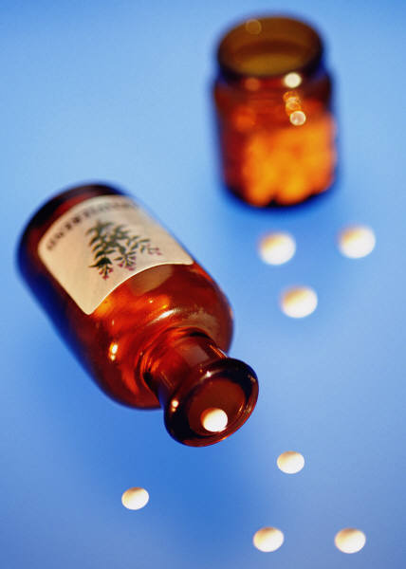
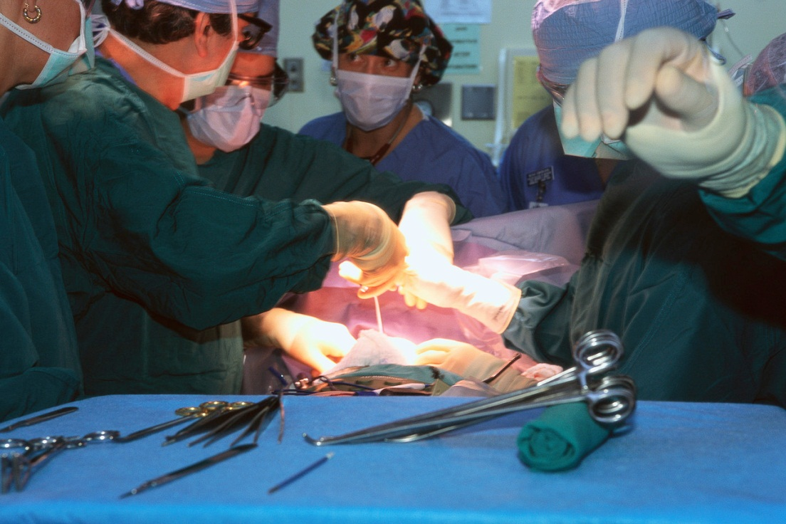
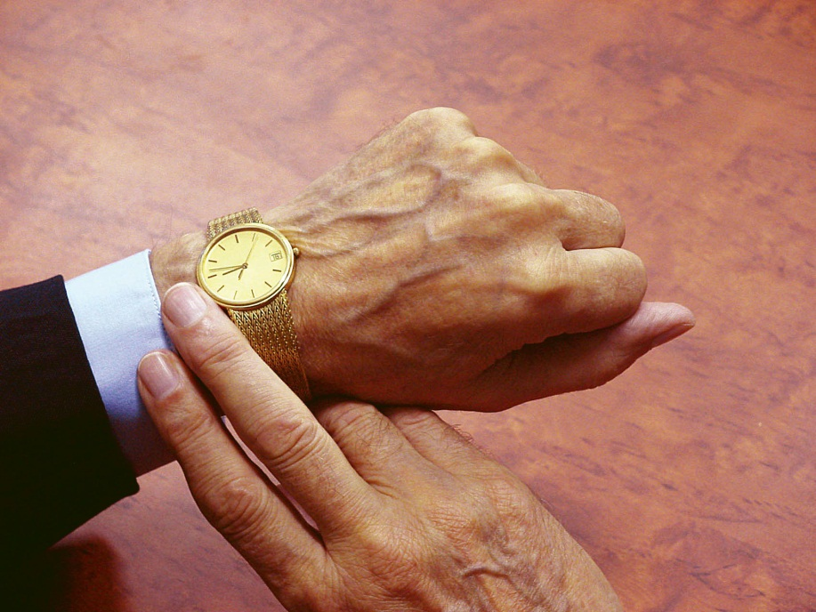
Notes:
Already, we have a small bank of quality improvement projects that have made positive changes in health care:
Reducing wait times – great project in Scotland!
Improving hand hygiene – compliance rates are on the rise in Ohio!
Improving medication processes and implement checklists to improve care.

Slide 17
What suggestions do you have to deal with underuse, overuse & misuse?

Slide 18
Potential Solutions
Acknowldege that this is an issue
Persuade: Clinician and patient education e.g. Choosing Wisely
Inform: Transparent reporting on underuse, overuse and misuse in health care
Pay: For quality, capitation, bundled payments, reduce administrative overhead
Information Technology
Regulate Pharma and device makers
Publicly fund clinical research

Slide 19
Thank you
Sameer V. Awsare, MD, FACP
Sameer.Awsare@kp.org

