Slide 1
Public and Private Health Coverage in the US, Update on Health Policy
Murray Ross, Vice President, Institute for Health Policy
KP-GWU Residency Elective; Berkeley CA October 16, 2017

Slide 2
Takeaway: public vs private may not be helpful dichotomy to assess system performance
Purchaser, Payers, Provider, and Patients (Consumers)
    VA, IHS: govt is purchaser, payer, and provider
    Medicare: govt is purchaser, one of payers, never provider
    Medicaid: govt is purchaser, one of payers, sometimes provider
    Private: employers purchase coverage, may take risk, but never act as payer (and only provider if in the industry)
Coverage one dimension; benefits, actuarial value matter
Difficult to evaluate public vs private performance
    Differences in health status across populations
    Differing objectives in public & private sectors
    Payment rates and cost-shifting
    Voluntary vs mandatory participation
    Innovations and interactions between public and private
Copyright © 2016 Kaiser Permanente, Slide 6
Notes:
(Premiums rate info: http://kff.org/private-insurance/press-release/visualizing-health-policy-recent-trends-in-employer-sponsored-health-insurance-premiums/)

Slide 3
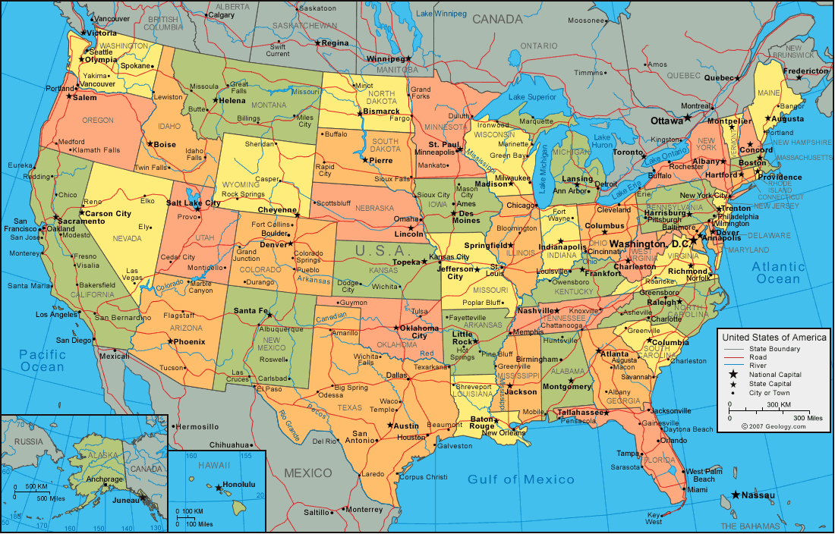
The US: big country, big health spending
320+ million people
  50 states + DC + territories;
  3,000 counties spread over 9 time zones
2015 spending: $3.2 trillion
  17.8% of GDP (highest on record)
  $9,990 per capita
  Both far outpace OECD countries
  Big industry
  14.6 million employees, 700,000 MDs
  5,000 community hospitals, (1,000 for profit, 1,000 state/local)
Image credit: http://geology.com/world/the-united-states-of-america-map.gif
Notes:
(Population data: http://www.usnews.com/opinion/blogs/robert-schlesinger/articles/2016-01-05/us-population-in-2016-according-to-census-estimates-322-762-018)
(Spending stat on GDP [2014 data]: https://www.cms.gov/research-statistics-data-and-systems/statistics-trends-and-reports/nationalhealthexpenddata/nationalhealthaccountshistorical.html)
(Spending stat on per capita cost [2013 data]: http://www.chcf.org/~/media/MEDIA%20LIBRARY%20Files/PDF/PDF%20H/PDF%20HealthCareCostsQRG15.pdf)

Slide 4
How Americans get health coverage
Source | 2013 |  | 2015
Employer | 50 |  | 49
Non-group | 4 |  | 7
Medicaid | 18 |  | 20
Medicare | 13 |  | 14
Other public | 2 |  | 2
Uninsured | 13 |  | 9
Total | 100 |  | 100
Source: Kaiser Family Foundation www.kff.org accessed 3/16/17
Notes:
(Source: Commonwealth Fund International Profiles of Health Systems, 2015 – http://www.commonwealthfund.org/~/media/files/publications/fund-report/2016/jan/1857_mossialos_intl_profiles_2015_v7.pdf)
(Uninsured info – 2014 info analyzed in fall 2015: http://kff.org/uninsured/fact-sheet/key-facts-about-the-uninsured-population/)
(Coverage gap info: http://kff.org/health-reform/issue-brief/the-coverage-gap-uninsured-poor-adults-in-states-that-do-not-expand-medicaid-an-update/)
FYI: re payments to providers
Medicare pays prospectively for all care
Capitation to health plans like Kaiser Permanente
DRGs for inpatient hospital stays (see next slide)
RBRVS for physician office visits
Medicaid uses a mix of (low) fee schedules and capitation
Private insurers use various methods—negotiating leverage critical
Per diems typical for hospital care
Physicians typically paid percentage (+/- 100) of Medicare rates
Pay for performance expanding, but slowly
Uninsured people typically liable for full charges (retail)

Slide 5
Evolution of coverage: 1932-1977
1932: Committee on the costs of Medical Care
1934: FDR Committee on Economic Security
1935: Social Security Act
1943: War Labor Board excludes fringe benefits from wage freeze
1946: Wagner-Murray-Dingell introduced
1954: Employer contributions for health insurance excluded from employees’ taxable income
1965: Medicare & Medicaid signed into law
1972: People w/ ESRD, disabilities covered by Medicare
1974: ERISA exempts self-insured employers from state coverage mandates
1977 Health Care Financing Administration established
Notes:
(Premiums rate info: http://kff.org/private-insurance/press-release/visualizing-health-policy-recent-trends-in-employer-sponsored-health-insurance-premiums/)

Slide 6
Evolution of coverage: 1978-1997
1981: OBRA ‘81 allows Medicaid managed care waivers
1983: DRGs introduced for hospital inpatient payments
1986: EMTALA
1988: Medicare Catastrophic Coverage Act adds Rx coverage (later repealed)
1990: OBRA’ 90 adds Medicaid coverage to kids <= 18
1993: Clinton Health Security Act
1996: HIPAA, Mental Health Parity, Medicaid delinked from welfare, banned for legal immigrants first 5 years
1997: BBA extends prospective payment to most Medicare providers, creates Medicare+Choice, creates State Children’s Health Insurance Program (S-CHIP), permits mandatory Medicaid managed care enrollment
Notes:
(Premiums rate info: http://kff.org/private-insurance/press-release/visualizing-health-policy-recent-trends-in-employer-sponsored-health-insurance-premiums/)

Slide 7
Evolution of coverage: 1998-present
2003: MMA establishes Part D to cover outpatient Rx drugs through private plans, creates HSAs to use pre-tax dollars in high-deductible plans
2006: Medicare drug benefit goes into effect
2006: Massachusetts enacts Romney-Care
2007: California fails to enact Schwarzenegger-care
2009: ARRA pumps stimulus money into state Medicaid programs, authorizes billions for HIT, establishes PCORI
2010: President Obama signs ACA to expand Medicaid, set individual & employer mandates, offer subsidized coverage of standardized benefits through insurance exchanges
2012: SCOTUS makes Medicaid expansion optional
2016: Republicans win White House and the Congress
Notes:
(Premiums rate info: http://kff.org/private-insurance/press-release/visualizing-health-policy-recent-trends-in-employer-sponsored-health-insurance-premiums/)

Slide 8
Republicans sweep the 2016 elections
Source: Dean Rosen, presented at UC-Irvine conference February 23, 2017

Slide 9
A brief history of the Affordable Care Act
  Signed into law 23rd March, 2010 with no Republican votes
  Since then, House of Representatives voted 50+ times to repeal or significantly weaken the law
  Opponents campaigned on “repeal” “rip it out root and branch” “drive a stake through the heart” and so on
  They were both reflecting but also creating a negative public perception of the law
  But negative polling overall counter-balanced by support for many/most of the components of the law
  And 20 million people actually got coverage …
  So now, talk of repeal turned to “repeal and replace”
Notes:
[MURRAY]
Main point(s):
The ACA has reconfigured the health care landscape in which Kaiser Permanente operates. I’m fond of saying that every single page of the ACA affected us and this will continue as the law evolves and as stakeholders adapt.
The scope of the changes challenged us in a number of ways. Not only were we pushed to adapt our products and capacity to a new reality, we had to do so in an environment where our regulators were figuring things out at the same time we were.
These challenges are very real, but we can’t lose sight of the opportunities. 500k people joined KP in 2014! And the market reforms that allow us to compete on quality and price are something we’ve sought for a long time

Slide 10
ACA approval rating: April 2010 - October 2016
Disapprove
Approve
Source: Real Clear Politics poll averages accessed 12/13/16

Slide 11
What Obamacare opponents dislike & like
  What do they dislike?
    Mandates on individuals and employers to buy coverage
    Minimum benefit standards
    Limits on premium variation by age and sex
    Income-based refundable tax credits
    Medicaid expansion
    The pay-fors (taxes and Medicare payment cuts)
  What do they like?
    Guaranteed issue and renewal
    Coverage of adult children to 26
    Access to coverage
Notes:
[MURRAY]
Main point(s):
The ACA has reconfigured the health care landscape in which Kaiser Permanente operates. I’m fond of saying that every single page of the ACA affected us and this will continue as the law evolves and as stakeholders adapt.
The scope of the changes challenged us in a number of ways. Not only were we pushed to adapt our products and capacity to a new reality, we had to do so in an environment where our regulators were figuring things out at the same time we were.
These challenges are very real, but we can’t lose sight of the opportunities. 500k people joined KP in 2014! And the market reforms that allow us to compete on quality and price are something we’ve sought for a long time

Slide 12
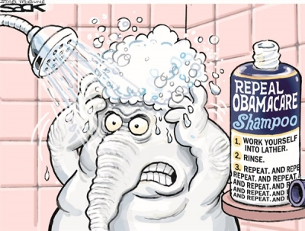
If at first you don’t succeed …

Slide 13
Repealing Obamacare: 6 dilemmas
  How do you repeal a law that benefits many of your constituents?
  Will partial and/or delayed repeal satisfy Republican voters?
  Can you repeal just the unpopular pieces of the ACA and still have something remaining that works?
  Can you do any of this in time for the 2018 elections without spooking the market?
  How do you keep Republican governors happy while you change the ACA’s Medicaid provisions?
  How do you get savings from repeal?
  With live ammunition in the chamber, talk of “repeal and replace” turned to “repeal and delay and replace”
Notes:
[MURRAY]
Main point(s):
The ACA has reconfigured the health care landscape in which Kaiser Permanente operates. I’m fond of saying that every single page of the ACA affected us and this will continue as the law evolves and as stakeholders adapt.
The scope of the changes challenged us in a number of ways. Not only were we pushed to adapt our products and capacity to a new reality, we had to do so in an environment where our regulators were figuring things out at the same time we were.
These challenges are very real, but we can’t lose sight of the opportunities. 500k people joined KP in 2014! And the market reforms that allow us to compete on quality and price are something we’ve sought for a long time

Slide 14
Why health reform is always on the agenda
Unsustainable growth in costs of care
    U.S. leads world in spending per capita and % of GDP
    Health costs rise faster than GDP even in good years
Care costs drive relentless premium increases
    Between 1999 and 2015, premiums increased by 203 percent, outpacing both inflation and workers’ earnings
    1990s managed care “revolution” was about market power, not changing underlying costs
    Premium growth moderated by benefit dilution—a blunt tool
    Only recently is attention shifting to delivery system reform
Dubious care quality
    Treatment of given diagnosis depends on location
    Known appropriate care not provided almost half the time
    Significant disparities in health and health care
Notes:
(Premiums rate info: http://kff.org/private-insurance/press-release/visualizing-health-policy-recent-trends-in-employer-sponsored-health-insurance-premiums/)

Slide 15
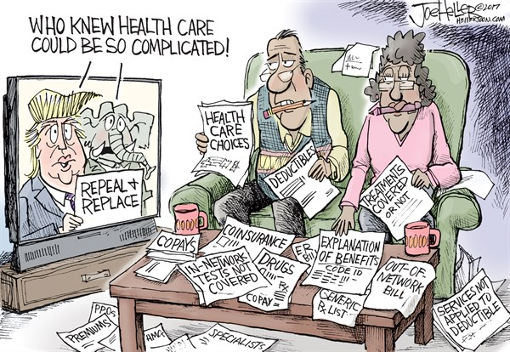
Health care is complicated. Who knew?

Slide 16
How might things move forward?
  Despite bold claims of action on Day 1, most changes to ACA require legislative action.
  To become law, identical bill must pass both House & Senate
    In the House, majority can do what it wants
    The Senate is more complicated; 60 votes needed for most legislation (but see below) and considerable deference to individual senators
  Slim majorities give factions power in both chambers
  Three-part strategy:
    Use “budget reconciliation” process to bypass Senate rules
    Use White House authority to make administrative changes
    Find 8 Democrats to pass non-budget changes next year
Notes:
[MURRAY]
Main point(s):
The ACA has reconfigured the health care landscape in which Kaiser Permanente operates. I’m fond of saying that every single page of the ACA affected us and this will continue as the law evolves and as stakeholders adapt.
The scope of the changes challenged us in a number of ways. Not only were we pushed to adapt our products and capacity to a new reality, we had to do so in an environment where our regulators were figuring things out at the same time we were.
These challenges are very real, but we can’t lose sight of the opportunities. 500k people joined KP in 2014! And the market reforms that allow us to compete on quality and price are something we’ve sought for a long time

Slide 17
Budget reconciliation (expert aside)
  Often referred to as an “arcane” parliamentary procedure, budget reconciliation is in fact a frequently used tool to move important legislation through the Senate
    Limits debate to 20 hours, prohibits filibusters, requires 51 votes for passage instead of 60, can only be used once for a fiscal year
    Congress passes a budget resolution that “instructs” the committees of jurisdiction to change existing law to bring spending and taxes in line with the resolution
    Specific dollar targets for specific committees (CBO scores)
  Byrd rule: parliamentary rule that provisions can be included only if they intentionally produce change spending or taxes
    Provisions that do not meet this standard (examined during a “Byrd bath”) are ruled extraneous and informally referred to as “Byrd droppings”
Notes:
[MURRAY]
Main point(s):
The ACA has reconfigured the health care landscape in which Kaiser Permanente operates. I’m fond of saying that every single page of the ACA affected us and this will continue as the law evolves and as stakeholders adapt.
The scope of the changes challenged us in a number of ways. Not only were we pushed to adapt our products and capacity to a new reality, we had to do so in an environment where our regulators were figuring things out at the same time we were.
These challenges are very real, but we can’t lose sight of the opportunities. 500k people joined KP in 2014! And the market reforms that allow us to compete on quality and price are something we’ve sought for a long time

Slide 18
Possible elements of ACA replacement
  Link guaranteed issue to continuous coverage not the individual mandate
  Much less regulation of benefit design and premiums
  High-deductible plans and health savings accounts to keep subsidy costs down
  Base subsidies on age, not income
  Allow/encourage sale of health insurance across state lines
  Cap Medicaid, give states more flexibility

Slide 19
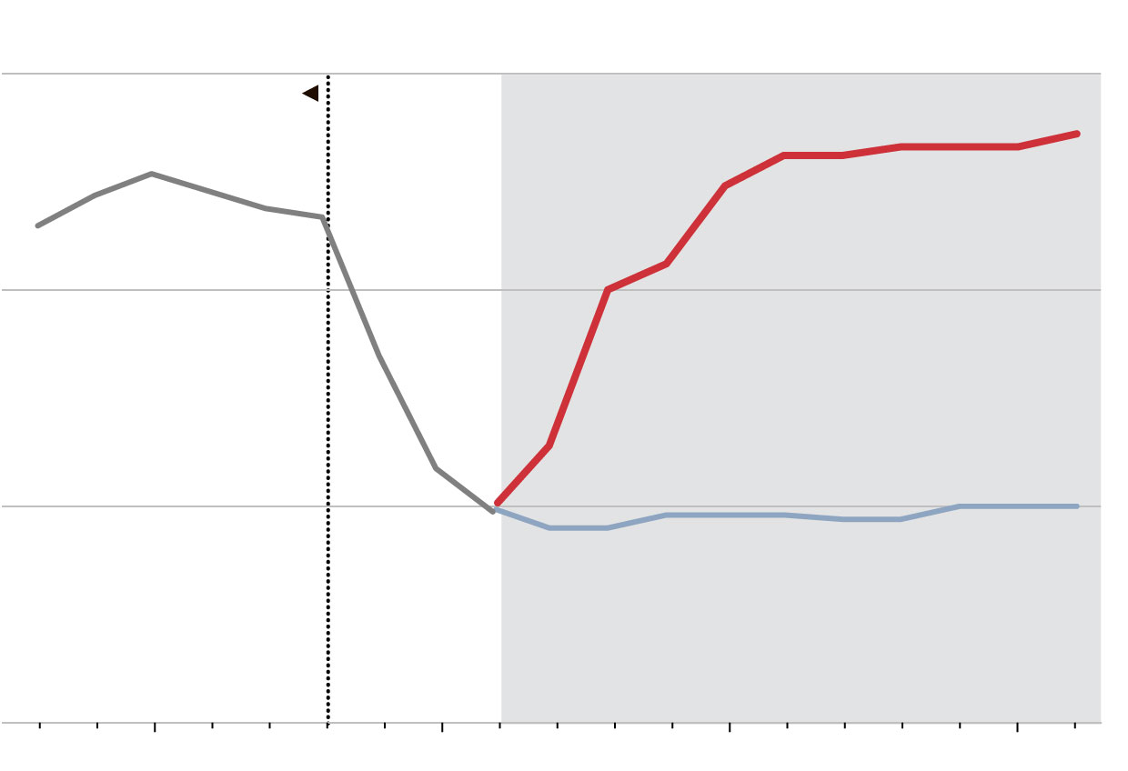
Health coverage: ACA vs House (R) Plan
Percentage of U.S. Residents under 65 without health insurance
20%
Actual
Pre-Affordable Care Act
Projected
House GOP Plan
15
10
Affordable Care Act
5
2010
2015
2020
2020
Source: Wall Street Journal 3/13/17 from U.S. Census data (actual) and Congressional Budget Office (projected).

Slide 20
Detail: Medicare payment evolution
1966-1983: some variation of usual, customary, reasonable
    Rapid growth in covered population
    No incentive to restrain cost growth
1983: DRGs introduced for inpatient care
    Incentive to discharge “quicker & sicker,” led to dramatic reduction in LOS, encouraged hospitals to move care into outpatient, reclassify costs
  1983: Medicare risk plans introduced
1997: SGR introduced for physician payments
  Previous “collective incentive” policies reduced payments if spending targets breached; no look-back
    SGR penalized spending growth above ½ historical norm, called for cuts to return to trend; result was politically unrealistic 20% cuts in MD fees
  2016: MACRA introduces MIPS and APMs
    Physicians not in APMs subject to new reporting requirements
    October 2017 MedPAC recommends repeal of MACRA
Notes:
[MURRAY]
Main point(s):
The ACA has reconfigured the health care landscape in which Kaiser Permanente operates. I’m fond of saying that every single page of the ACA affected us and this will continue as the law evolves and as stakeholders adapt.
The scope of the changes challenged us in a number of ways. Not only were we pushed to adapt our products and capacity to a new reality, we had to do so in an environment where our regulators were figuring things out at the same time we were.
These challenges are very real, but we can’t lose sight of the opportunities. 500k people joined KP in 2014! And the market reforms that allow us to compete on quality and price are something we’ve sought for a long time

Slide 21
The next frontier: Rx drug pricing
High price of drugs threatens to put vital therapies out of reach for many patients and strains budgets
  Specialty drug prices are growing at rates far outpacing the consumer price index and medical inflation
  Prices of certain generic drugs, even ones that have been around for decades, are spiking up
Broken market inconsistent with affordability
  Many drugs are insulated from usual market forces with prices escalating under initial monopolies and then continuing to rise even when competition is introduced
Still more about broad education than “solving” – although policy options are being discussed
  Transparency laws in states an example of good first step
  CSRxP Coalition
Notes:
Spending on medicines was at the highest level last year since 2001.
Per the IMS report:
“Real per capita spending was $995 in 2014 and has nearly tripled since 1995 when it was $339, both measured in 2005 dollars.
Higher spending growth between 1997 and 2003 reflected the period when the largest number of blockbuster drugs launched and were increasingly used by millions of Americans.
Lower levels of growth in spending between 2002 and 2013 were due to lower volume growth, increased use of generics, loss of patent protection for major branded products and reduced spending on new drugs.
The sharp increase in spending in 2014 was driven by new brands, lower impact from patent expiries and increases in the list prices of branded medicines.”
This presentation is about that last point: the increase in the list prices of branded medicines. Why that’s happening, what it means, and what we should do.

Slide 22

Discussion

