Slide 1
Introduction to Health Economics
Joseph Houska, PhD
Lecturer, School of Public Health
University of California, Berkeley
October 18, 2017

Slide 2
Today’s Agenda
What is economics?
How do economists think?
What do economists believe?
What is special about health economics?
What are the current issues in health economics?

Slide 3
What is economics?
Economics does not have the best reputation
An economist states the obvious in terms of the incomprehensible.
Alfred A. Knopf
If all the economists were laid end to end they would not reach a conclusion.
George Bernard Shaw
The dismal science.
Carlyle and many others over the years
Notes:
And compared to doctors or lawyers?

Slide 4
What is economics?
One of the Social Sciences
Subject matter is about people and their interactions
Observation-Theory-Observation
The role of assumptions to assist understanding
Simplified reality in models
Those social sciences broadly consider human decisions
Political Science is about the domain of authority
Philosophy (and in modern times Psychology) is about the domain of persuasion
Economics is about the domain of markets and allocation of scarce resources

Slide 5
What is Economics?
Economics’ Subject matter: human production, consumption, distribution and exchange—particularly via markets
Economics is the science that answers the questions
What goods and services are produced?
How to produce them?
Who gets them?
Characteristics of the Science of Economics
Strong assumptions concerning rationality and the pursuit of wealth
Method—highly theory and model driven
Mathematical rigor
Both data rich and data poor
Overdetermined systems

Slide 6
How do economists think?
Scarcity—dismal
Constrained optimization, the best I can do given the constraints and uncertainties that I face
Expression of economics—sometimes obvious, sometimes incomprehensible but also important and subject to elucidation
Intuitive
Graphical
Mathematical
Notes:
Mention the role of the model that displays the relationship of two or more economic variables—fits reality and is tractable

Slide 7
An Economics Model in Practice
Cost
Marginal benefit
Q1 Socially optimal amount of care
Q2 Technologic optimal amount of care
Marginal cost
0
Q1
Q2
Quantity of medical care

Slide 8
How do economists think?
Theoretical and empirical approaches are both valid
Economics is both positive and normative, descriptive (science) and prescriptive (policy)
Division into micro- and macro-economics orders the field
Notes:
PPE—Philosophy, Politics, and Economics

Slide 9
What do economists believe?
Among the additional beliefs of economists:
People face trade offs
Cost is what you give up for something
Rational decision-making often requires thinking at the margin
Efficiency is good
People respond to incentives
Markets are usually good
Prices help resolve issues involving scarcity
Government can sometimes improve market functioning (market failure)
Efficiency and equality need a lot of discussion
And there is a lot more to say about the macro-economics of growth, inflation, GDP, employment
Notes:
Scarcity again
Could be money, time, etc. Includes decision costs as well.
Not just money. Unfortunately often they do exactly what you incent them for and not much else.
Usually, especially if it is a good market. Think farmer’s markets. Think auctions. Think exchanges for stock and fish.
Yea, sometimes

Slide 10
So what is special about Health Economics
With some apologies to Kenneth Arrow
High levels of government involvement as payer and regulator
Lots of externalities
Intractable uncertainty
Asymmetric information
Third party agency—payers and providers of care, especially physicians
High stakes: life and death, health and illness for individual, trillions for society
Highly charged normative questions
Uncertain “product” definition
Highly skewed consumption across the population
What is really special is that all the above apply to Health Economics
Notes:
Government as buyer and regulator
Externalities include sickness, communicable disease, loss of productivity
Uncertainty is huge in means/ends decisions, treatment, and what creates value—seat belts and cigarettes
Asymmetric information
Third party agency
Stakes--heading toward 3.5 Trillion and it ain’t over yet. Baby boom health expenses; shortages of medical professionals
Normative questions like kidney ebay sale
Product: Health, Relief of Pain, relief of worry, QALY, discounted for future. What to optimize?

Slide 11
US Health Care Spending, Payment Sources, 2015
Payment Sources for US Health Care Spending
Medicare—22%
Medicaid—17%
CHIP—1%
Other Government Paid (Including Military, Veterans, Indian Health Services)—4%
Government civilian employees—6% (estimated, includes all levels of government)
Public Health Expenditures--3%
Government Administration—1%
Tax expenditures—unknown to me but substantial, probably more than 4%

Slide 12
The US Health Care Spending in International Perspective

Slide 13
Health Care Spending Consume a Large and Growing Share of US GDP

Slide 14
So what is special about Health Economics
With some apologies to Kenneth Arrow
High levels of government involvement as payer and regulator
Lots of externalities
Intractable uncertainty
Asymmetric information
Third party agency—payers and providers of care, especially physicians
High stakes: life and death, health and illness for individual, trillions for society
Highly charged normative questions
Uncertain “product” definition
Highly skewed consumption across the population
What is really special is that all the above apply to Health Economics
Notes:
Government as buyer and regulator
Externalities include sickness, communicable disease, loss of productivity
Uncertainty is huge in means/ends decisions, treatment, and what creates value—seat belts and cigarettes
Asymmetric information
Third party agency
Stakes--heading toward 3.5 Trillion and it ain’t over yet. Baby boom health expenses; shortages of medical professionals
Normative questions like kidney ebay sale
Product: Health, Relief of Pain, relief of worry, QALY, discounted for future. What to optimize?

Slide 15
Out-of-Pocket Spending Grows and Declines

Slide 16
So what is special about Health Economics
With some apologies to Kenneth Arrow
High levels of government involvement as payer and regulator
Lots of externalities
Intractable uncertainty
Asymmetric information
Third party agency—payers and providers of care, especially physicians
High stakes: life and death, health and illness for individual, trillions for society
Highly charged normative questions
Uncertain “product” definition
Highly skewed consumption across the population
What is really special is that all the above apply to Health Economics
Notes:
Government as buyer and regulator
Externalities include sickness, communicable disease, loss of productivity
Uncertainty is huge in means/ends decisions, treatment, and what creates value—seat belts and cigarettes
Asymmetric information
Third party agency
Stakes--heading toward 3.5 Trillion and it ain’t over yet. Baby boom health expenses; shortages of medical professionals
Normative questions like kidney ebay sale
Product: Health, Relief of Pain, relief of worry, QALY, discounted for future. What to optimize?

Slide 17
Spending varies considerably across the population

Slide 18
Some Key Issues in Health Economics
Third Party Payers
Moral Hazard
Health Insurance
Risk pools
Pre-existing conditions/Guaranteed issue
Fee for Service, UCR, Re-imbursement, Indemnity, Pre-payment, Bundled Payment, Capitation
Any willing provider—limitations on the market
Health care ”guilds”
Vertical and horizontal integration
Adverse selection
Death spiral
Market failure

Slide 19
Health Economic Issues Today
ACA and Responses to the ACA
Individual mandate
Guaranteed Issue
Pre-existing conditions
Administrative Costs
Out of Pocket Costs: Premiums, deductibles, copays, co-insurance, un-covered services
Cost-sharing subsidies
Essential benefits
Whither health insurance
What care to deliver to whom; what is the goal to be subject to constrained optimization?

Slide 20
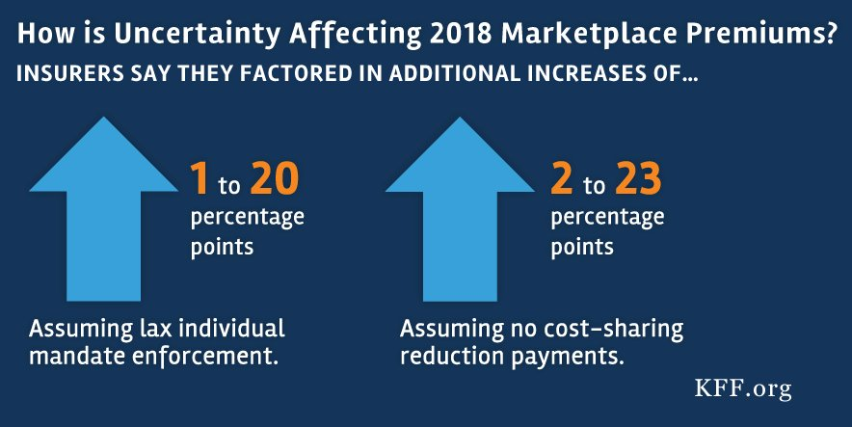
Uncertainty Drives Higher Health Insurance Costs

Slide 21
Health Economic Issues Today
ACA and Responses to the ACA
Individual mandate
Guaranteed Issue
Pre-existing conditions
Administrative Costs
Out of Pocket Costs: Premiums, deductibles, copays, co-insurance, un-covered services
Cost sharing
Cost-sharing subsidies
Essential benefits
Whither health insurance?
What care to deliver to whom; what is the goal to be subject to constrained optimization?

