Slide 2
Un-Healthy Housing Case Study::Oakland, CA
Hospitalization rate for Child Asthma 5x more than State rate
1,751 lead-poisoned children in Alameda County—62% in Oakland
$150 million annual cost of lead poisoning (medical, special ed, lost wages)
Over 30,000 Oakland blight complaints from 2013-2014
Substandard housing EXACERBATED by today’s housing crisis

Slide 3
Housing Crisis = New Homeless Crisis
39% increase in homeless in 2 years
New homeless b/c of economic factors
70% of tenants in court evictions have no legal representation
Populations most impacted:
Older Adults
Single headed households w/ kids
Formerly incarcerated
Students

Slide 4
The New Unequal Economy

Slide 5
Housing WAY Out of Reach ________________________________________________________________
City | 2014 Median Rent | 2016 Median Rent | % Rent Increase | Median Renter HH Income | % Income Toward Market Rent
Alameda | $2,298 | $3,385 | 47% | $52,617 | 77%
Albany | $2,343 | $3,455 | 47% | $52,500 | 79%
Berkeley | $2,539 | $3,653 | 44% | $38,539 | 114%
Castro Valley | $2,170 | $2,971 | 37% | $50,430 | 71%
Dublin | $2,158 | $3,147 | 46% | $91,343 | 41%
Emeryville | $1,555 | $2,575 | 66% | $63,080 | 49%
Fremont | $2,163 | $3,123 | 44% | $76,655 | 49%
Hayward | $1,755 | $2,544 | 45% | $44,064 | 69%
Livermore | $2,119 | $2,926 | 38% | $55,403 | 63%
Newark | $2,009 | $2,854 | 42% | $59,269 | 58%
Oakland | $1,838 | $2,835 | 54% | $36,657 | 93%
Piedmont | $4,538 | $6,711 | 48% | $74,861 | 108%
Pleasanton | $2,509 | $3,524 | 40% | $74,151 | 57%
San Leandro | $1,815 | $2,518 | 39% | $47,090 | 64%
San Lorenzo | $1,746 | $2,524 | 45% | $57,522 | 53%
Union City | $2,082 | $2,941 | 41% | $54,871 | 64%
Alameda County Total | $2,400 | $2,800 | 17% | $46,851 | 72%
54% increase in median rent in 2 years
Median rents ~$3,000
Median HH income $36,000

Slide 6
Urban Housing=Racial Justice Crisis
The displacement crisis has disproportionately impacted African Americans—reduction of 36,559 in Oakland (26%) & 5,040 in Berkeley (37%).
Across the County, with a few exceptions, African American income & homeownership rate have declined more than any other group.
African Americans and Latinos are severely under-represented in the Bay Area new high wage growth jobs.

Slide 7
Racially Targeted Displacement

Slide 8
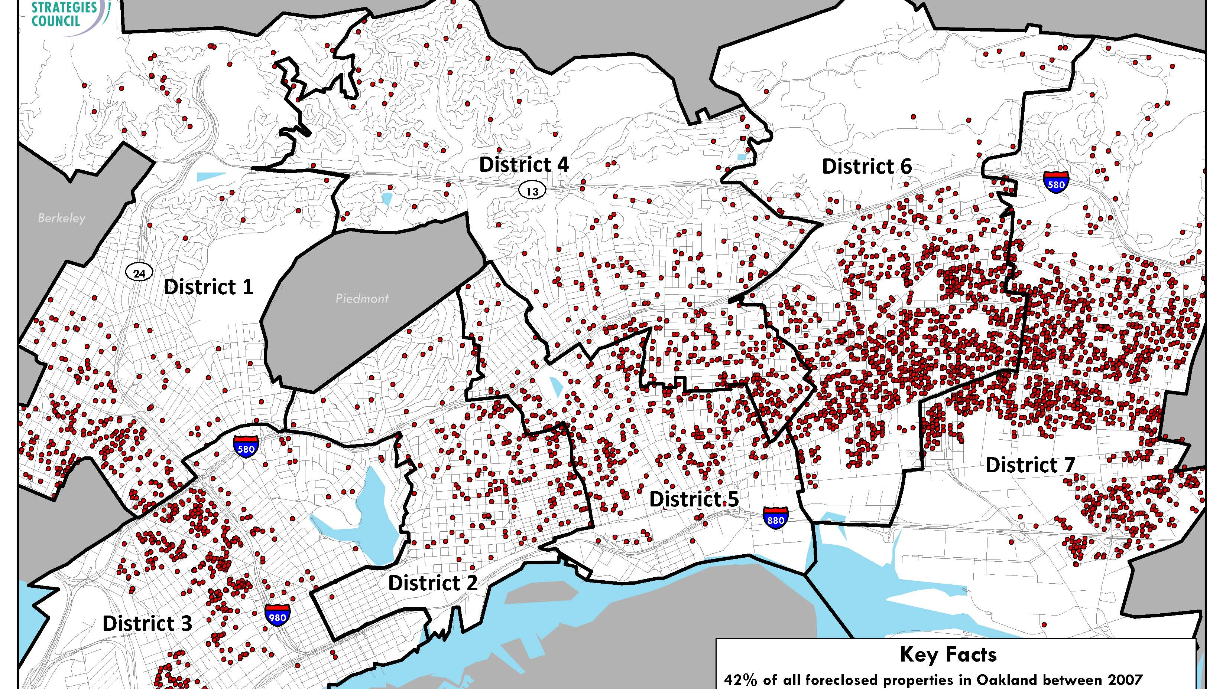

Slide 9
Racist Roots of Today’s Housing Crisis

Slide 10
Redlining of Today’s Nonprofit “Solutions”

Slide 11
Solutions—Structural Policy Change

Slide 12
What about the Doctors?
Diagnose Structural Roots of Problem & ”Prescribe” the Right Solutions (instead of treating just the symptoms)
Power of Health Champions & the Raised Fist

Slide 13
In the Beloved Community, poverty, hunger, and homelessness will not exist…because human decency will not tolerate it.

